Slide 1


BudgetMate
Personal Budget Management App
An intuitive and feature-rich app to help users efficiently manage their personal finances and track income and expenses.

Slide 2

Introduction
1
Streamline Financial Management
BudgetMate helps users stay on top of their financial activities.
Comprehensive Tracking
2
Monitor income, expenses, and savings in one centralized location.
Empowered Decision-Making
3
Visual insights enable informed financial decisions.

Slide 3
Problem Statement
Budgeting Challenges
Lack of Visibility
Time-Consuming Processes
Users often lack clear insights into their financial status.
Many struggle to effectively track income and expenses.
Managing finances manually can be tedious and error-prone.

Slide 4

Project Objectives
Efficient Tracking
1
Enable users to easily manage income and expenses.
2
Insightful Analytics
Provide visual representations of financial data.
Intuitive Interface
3
Deliver a user-friendly experience for all ages.

Slide 5

Target Audience
Teenagers
Develop financial literacy from an early age.
Young Professionals
Manage income and expenses more effectively.
Older Adults
Simplify financial tracking in retirement years.
Everyone
Empower all users to take control of their finances.

Slide 6

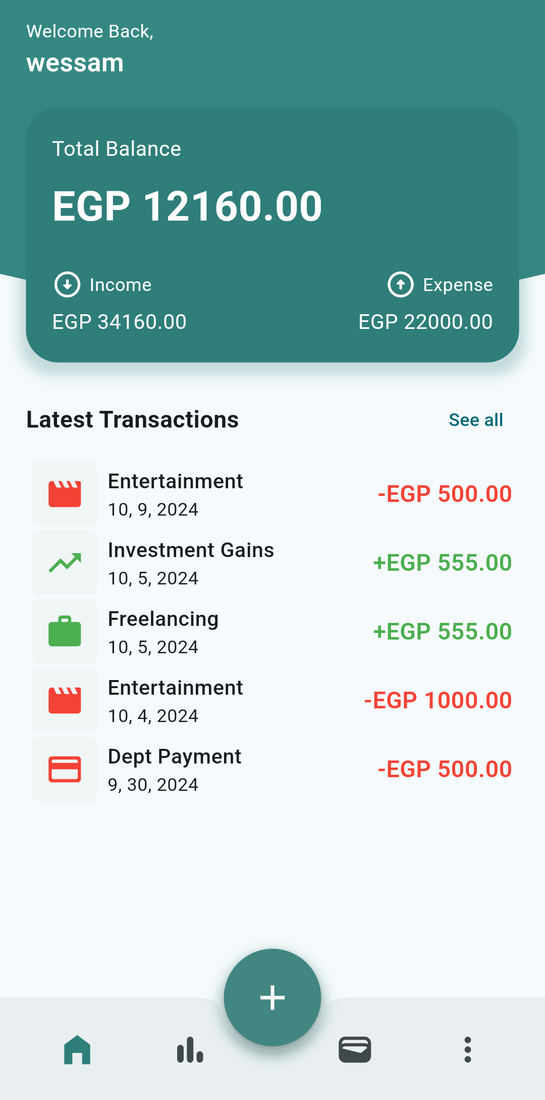




Key Features
Add Transactions
Easily log income and expenses.
View Statistics
Analyze spending patterns with visual charts.
Manage Wallet
Track account balances and transactions.
Upload Invoices
Attach receipts to transaction records.

Slide 7
Design Overview
Simplicity
Aesthetics
Usability
Intuitive layout and navigation for all users.
Visually pleasing design with a calming palette.
Seamless interactions and quick task completion.

Slide 8
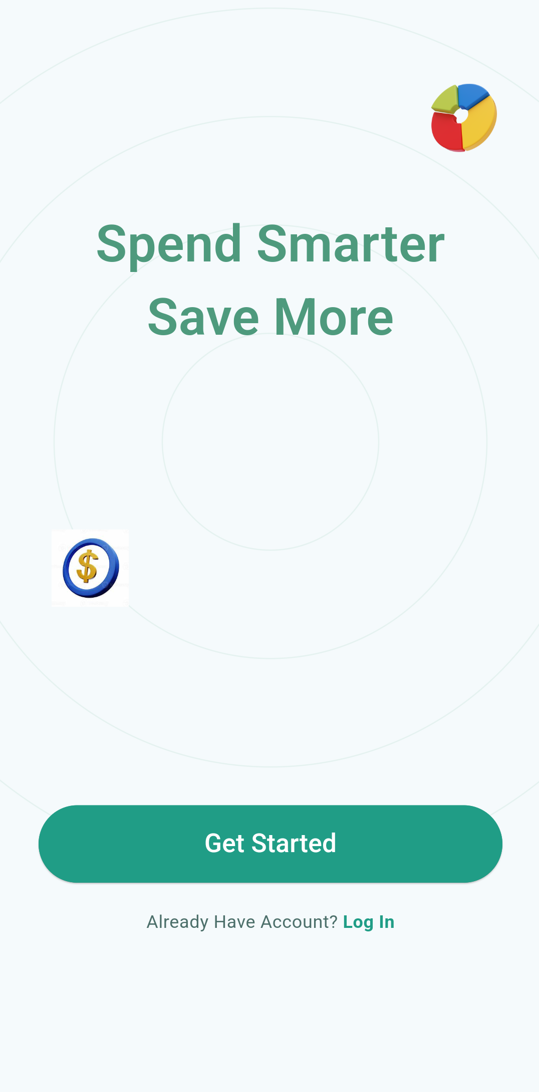
Welcome Page (One-Time)
This is the first screen users see upon launching the app for the first time. The welcome message, "Spend Smarter, Save More," encourages users to engage with the app by clicking the "Get Started" button. Returning users are offered a "Log In" option at the bottom to quickly access their accounts. The design is minimalistic and focuses on inviting users to start their budgeting journey.

Slide 9
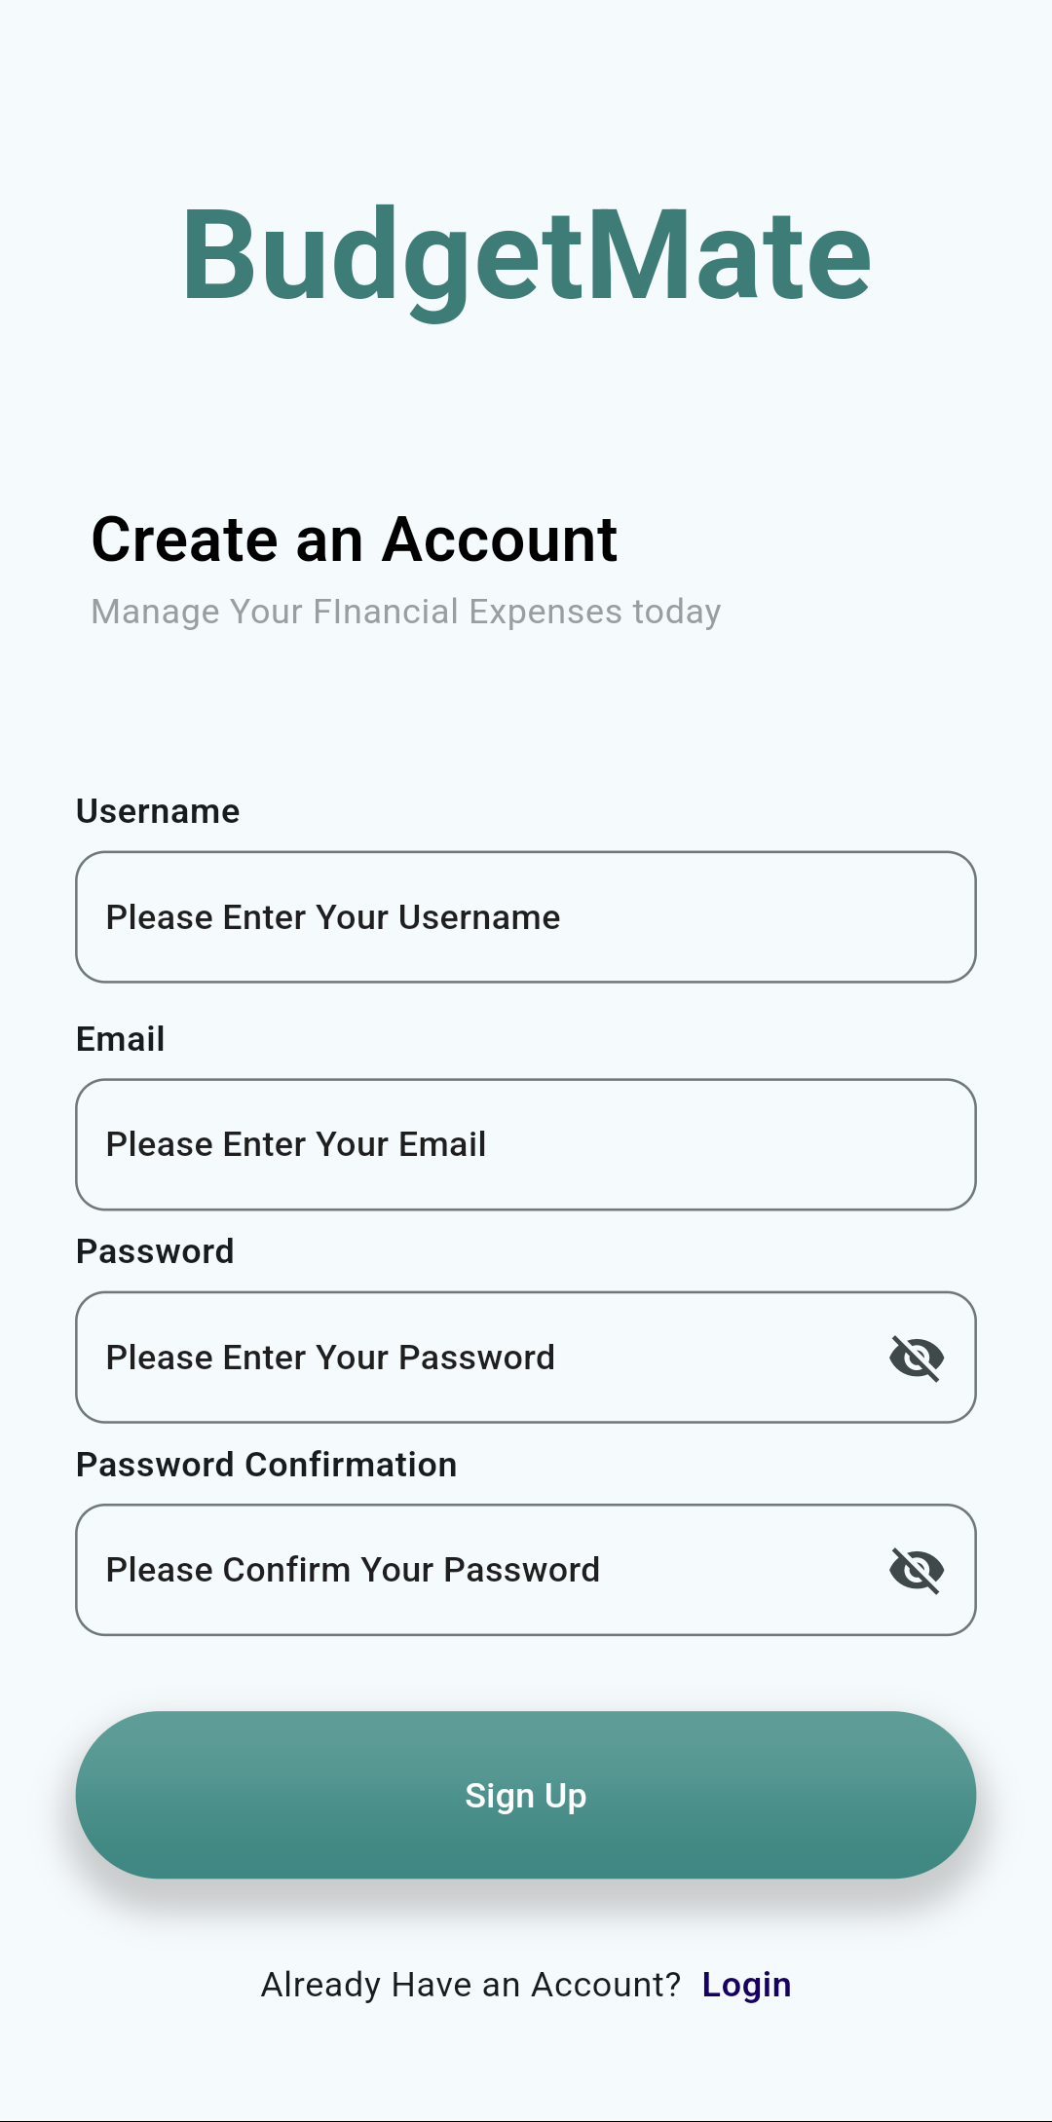
Registration Page
This screen allows new users to create an account on the BudgetMate app. Users are prompted to provide a username, email, password, and confirm the password. The design focuses on simplicity, with clearly labeled fields and a "Sign Up" button. For returning users, a "Login" link is also available, allowing quick access to their account.

Slide 10
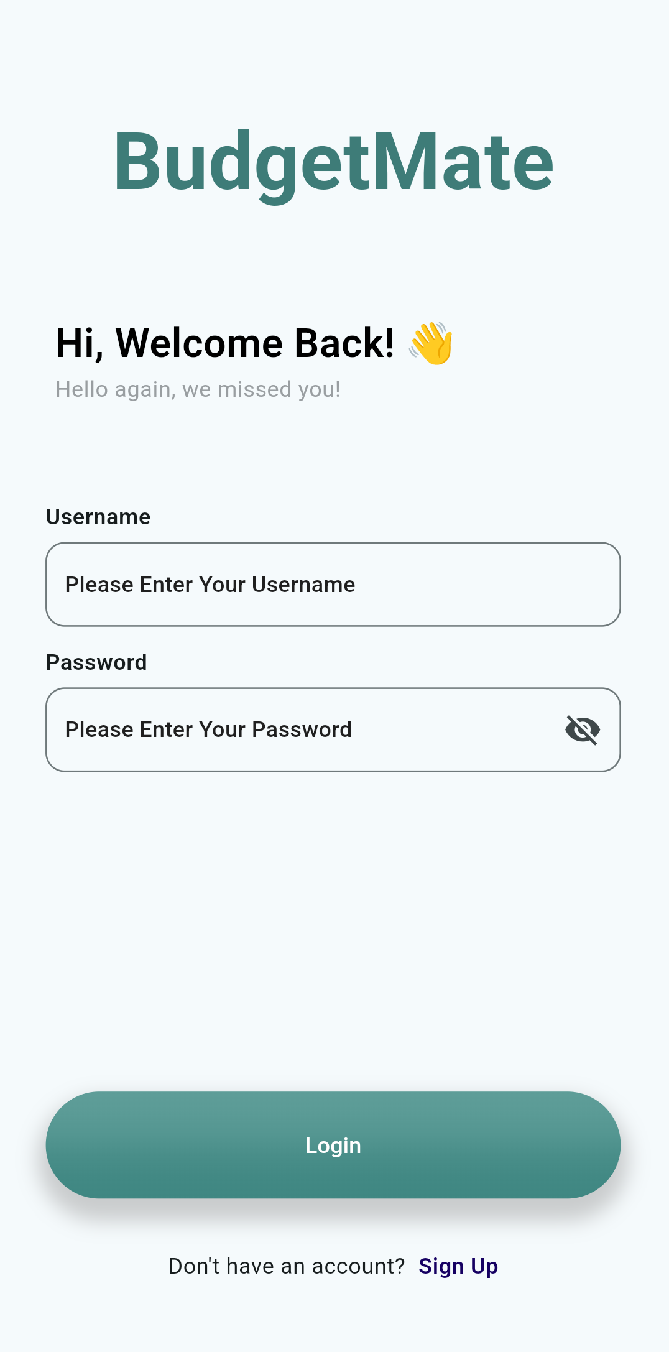
Login Page
This screen is for returning users to log in to the BudgetMate app. It greets users with a friendly message, "Hi, Welcome Back!" and provides input fields for the username and password. A "Login" button allows users to sign in, and for new users, there is a link to the "Sign Up" page to create an account. The overall design matches the registration page, maintaining consistency throughout the app.

Slide 11
Dashboard Page
The dashboard page serves as the central hub of the app, offering a concise overview of the user's financial situation. It displays the current net balance, summarizes income and expenses, and showcases recent transactions. Additionally, the page includes navigation buttons for quick access to other app features, making it a convenient starting point for managing finances.

Slide 12
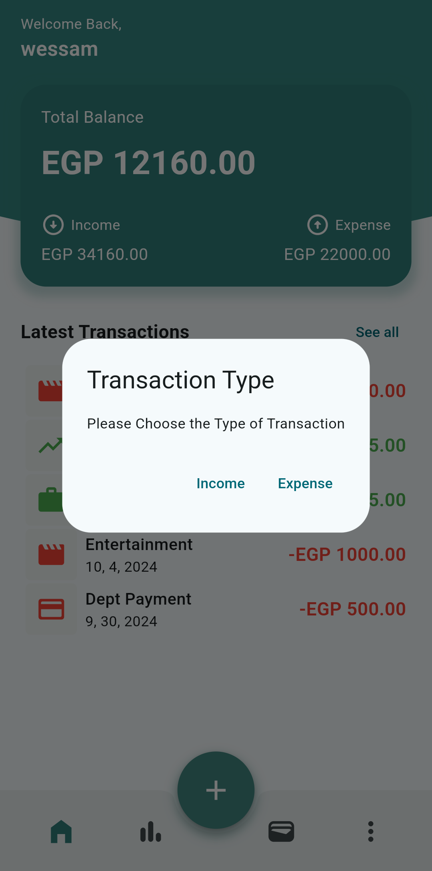
TransactionType Modal
This modal, which appears after tapping the plus button on the dashboard, presents users with a simple choice: whether to add an income or expense transaction. The modal features two prominent buttons, "Income" and "Expense," guiding users toward the appropriate input screen based on their selection.

Slide 13
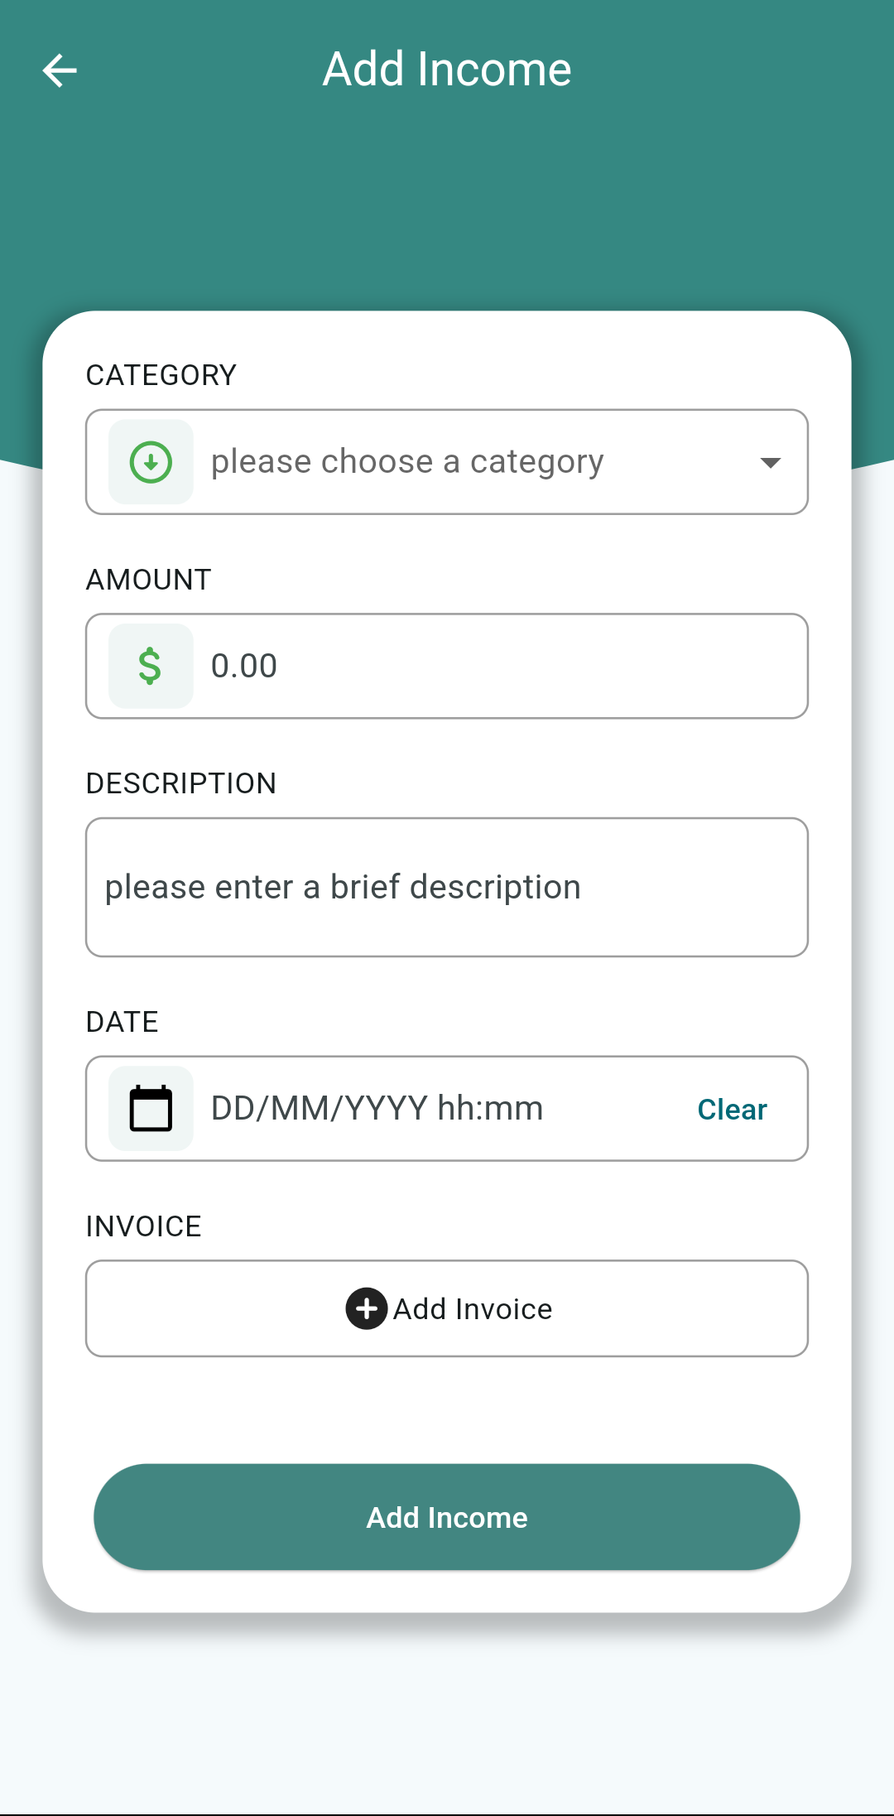
Add Income Page
This page allows users to input details for a new income transaction. Including:
Category: Users select a category to classify the income source.
Description: Users provide a brief description of the income source.
Invoice: Users can optionally attach an invoice or receipt related to the income.
The page also features an "Add Income" button to confirm the transaction and save it to the user's records.

Slide 14
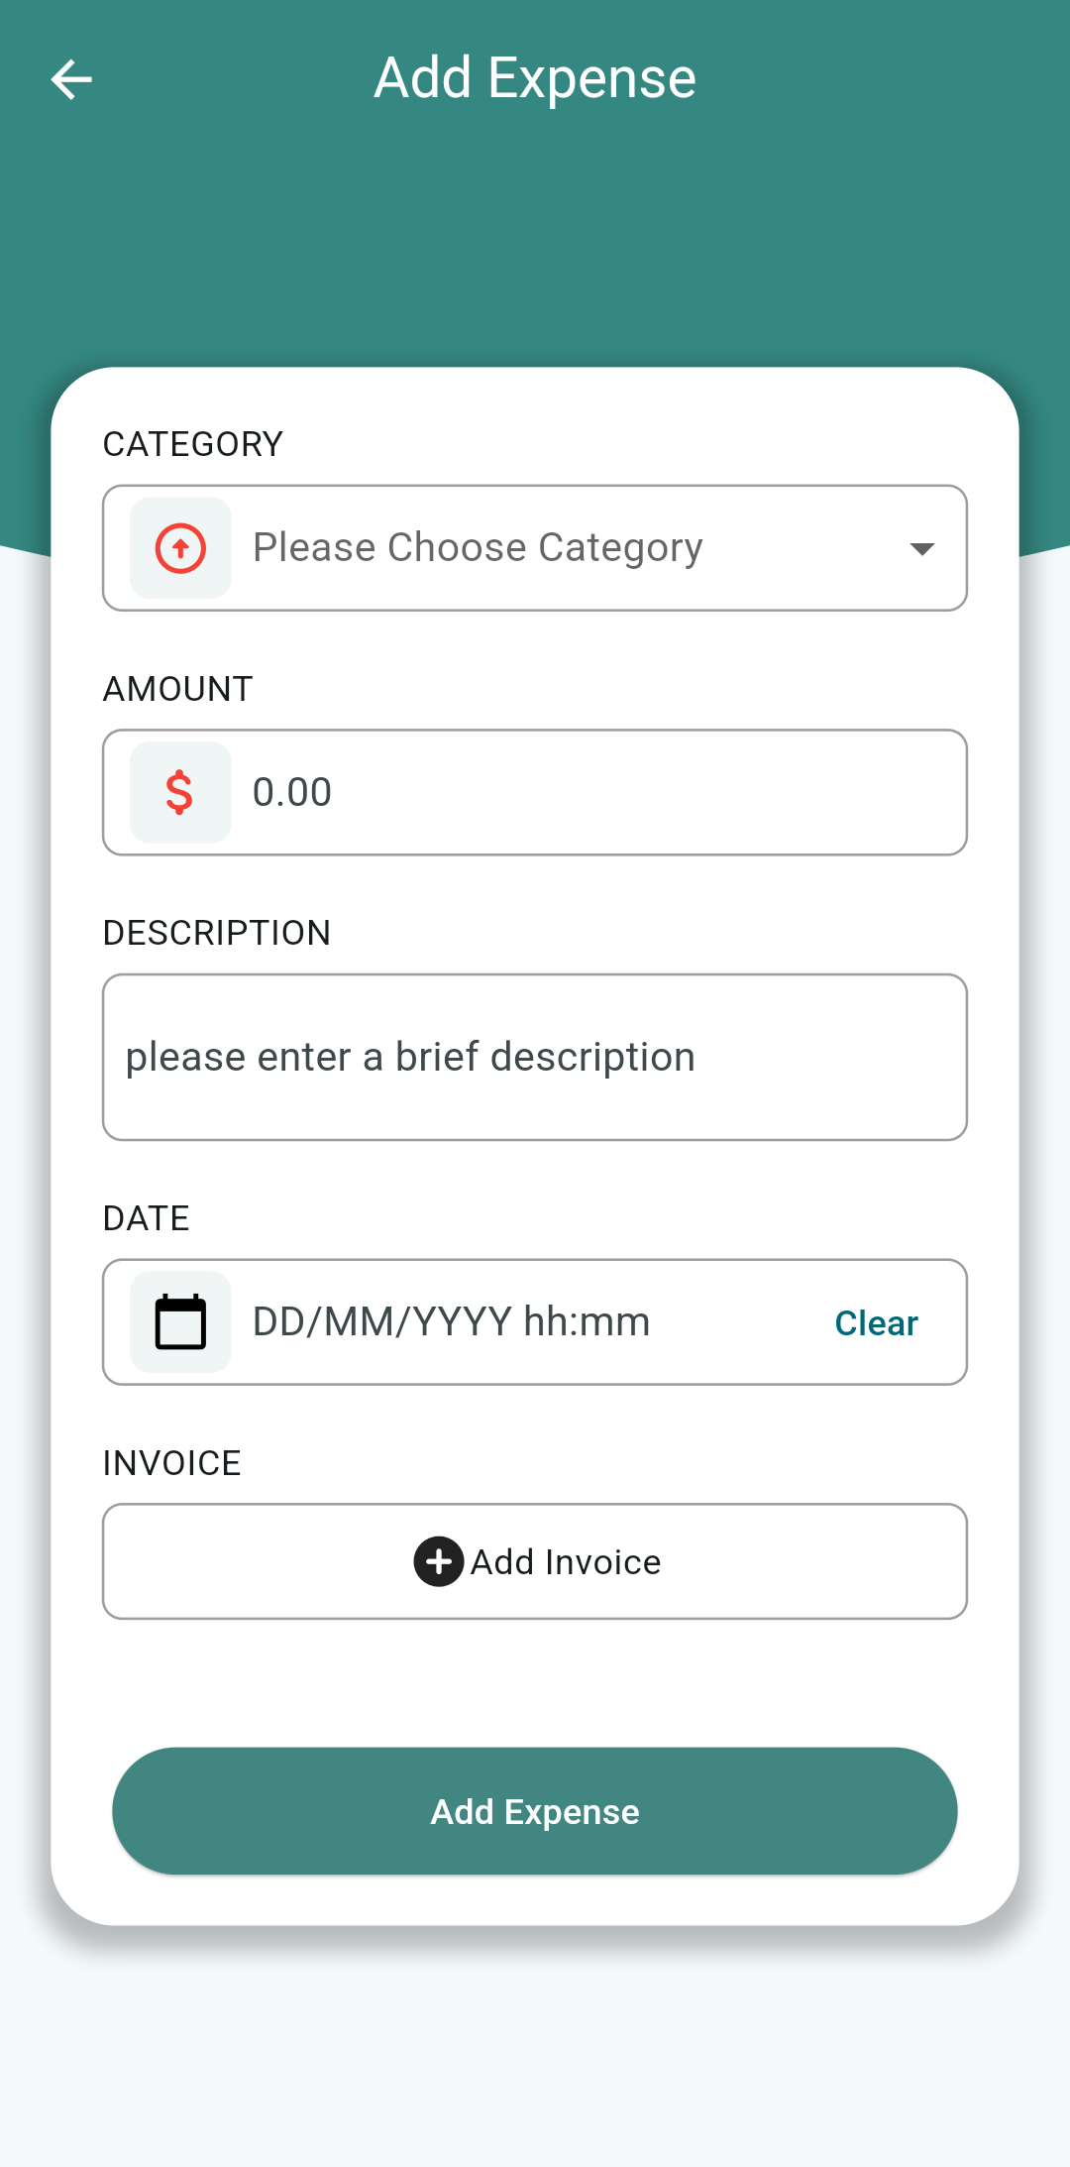
Add Expense Page
This page allows users to input details for a new Expense transaction. Including:
Category: Users select a category to classify the income source.
Description: Users provide a brief description of the income source.
Invoice: Users can optionally attach an invoice or receipt related to the income.
The page also features an "Add Expense" button to confirm the transaction and save it to the user's records.

Slide 15
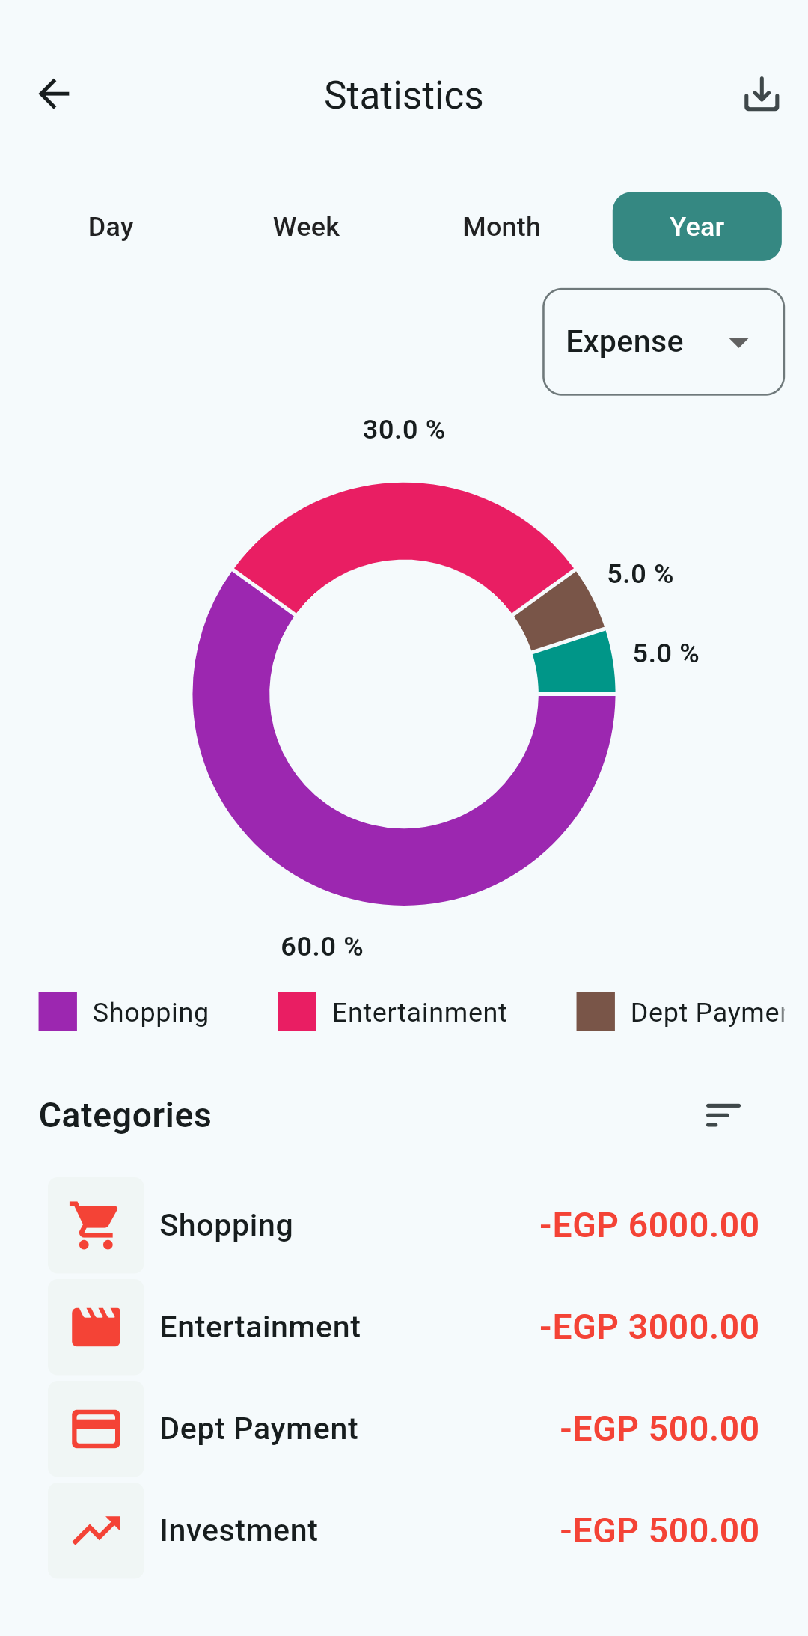
Statistics Page
This page provides a visual representation of the user's financial data, and saving this representation for future reference It includes:
Timeframe Selector: Users can choose to view statistics for the day, week, month, or year.
Pie Chart: A pie chart displays the percentage breakdown of expenses across different categories.
Category Breakdown: A list shows the total amount spent in each category, accompanied by icons for visual representation.
This page offers users a quick and easy way to understand their spending patterns and identify areas where they might need to adjust their budget.

Slide 16
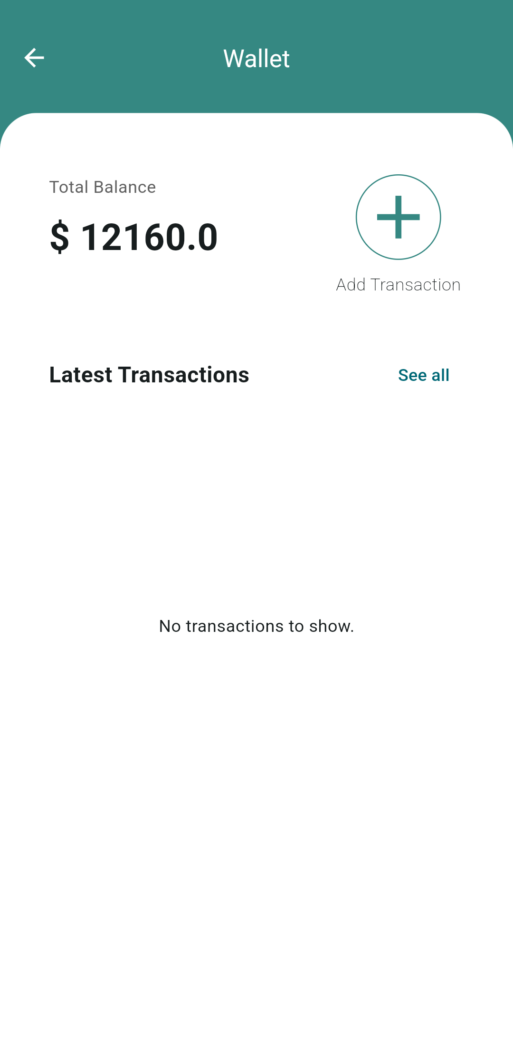
Wallet Page
The Wallet page serves as a central hub for managing the user's finances. It provides a clear overview of their:
Total Balance: Displays the current net balance, summarizing the difference between income and expenses.
Latest Transactions: Shows a list of today's transactions, allowing users to quickly review their most recent financial activity.
Add Transaction Button: Provides a convenient way to add new income or expense transactions.
This page offers users a straightforward interface for tracking their financial status and initiating transactions.

Slide 17
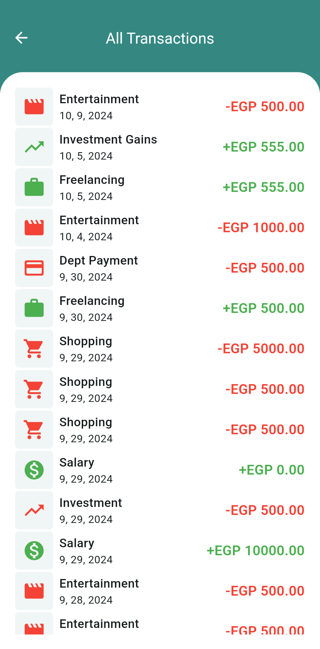
All Transactions Page
This page provides a comprehensive list of all recorded transactions, allowing users to view their financial history in detail. The transactions are displayed in chronological order with the following information:
Category: The category associated with the transaction.
Date: The date and time of the transaction.
Amount: The monetary value of the transaction, including whether it's an income or expense.
Users can scroll through the list to examine specific transactions.
May add Search Filters in the Future

Slide 18
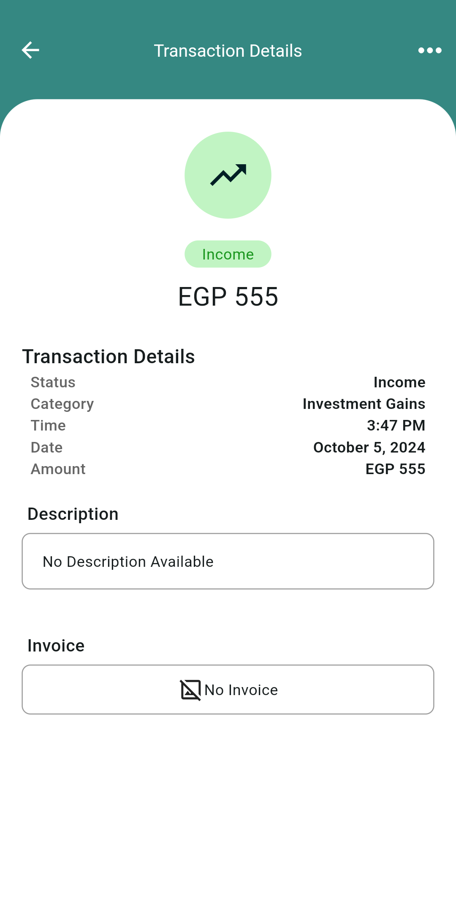
Transaction Details
This page provides detailed information about a specific transaction. It typically includes:
Transaction Type: Indicates whether it's an income or expense.
Amount: Displays the monetary value of the transaction.
Category: Shows the category to which the transaction belongs.
Date and Time: Specifies the date and time of the transaction.
Status: Indicates the Type of the Transaction (Income or Expense).
Description: Show brief description of the transaction.
Invoice: Displays any associated invoice or receipt Images.
This page offers users a comprehensive view of transaction details, enabling them to review and analyze their financial activity in depth.

Slide 19
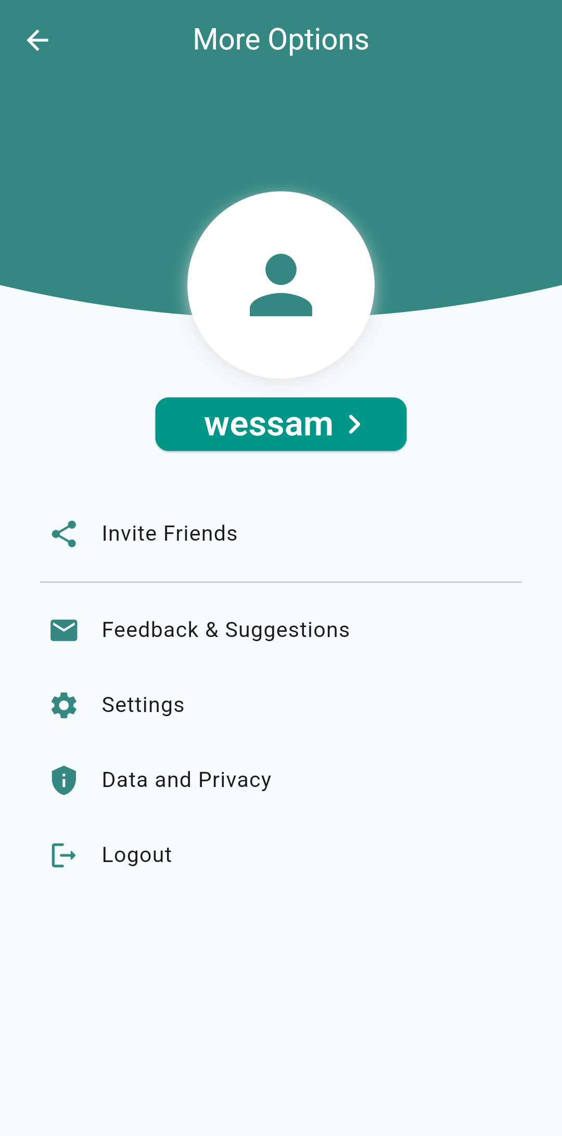
More Options Page
The More Options page provides additional features and settings related to the user's account and the app. It typically includes options such as:
Profile: Displays the user's profile information and allows for customization.
Invite Friends: Enables users to invite friends to join the app.
Feedback & Suggestions: Provides a channel for users to share feedback and suggestions with the app developer.
Settings: Opens the Settings page for customizing app preferences.
Data and Privacy: Allows users to access information about the app's data handling practices.
Logout: Enables users to log out of their account.
This page offers users a centralized location to access additional features and manage their account settings.

Slide 20
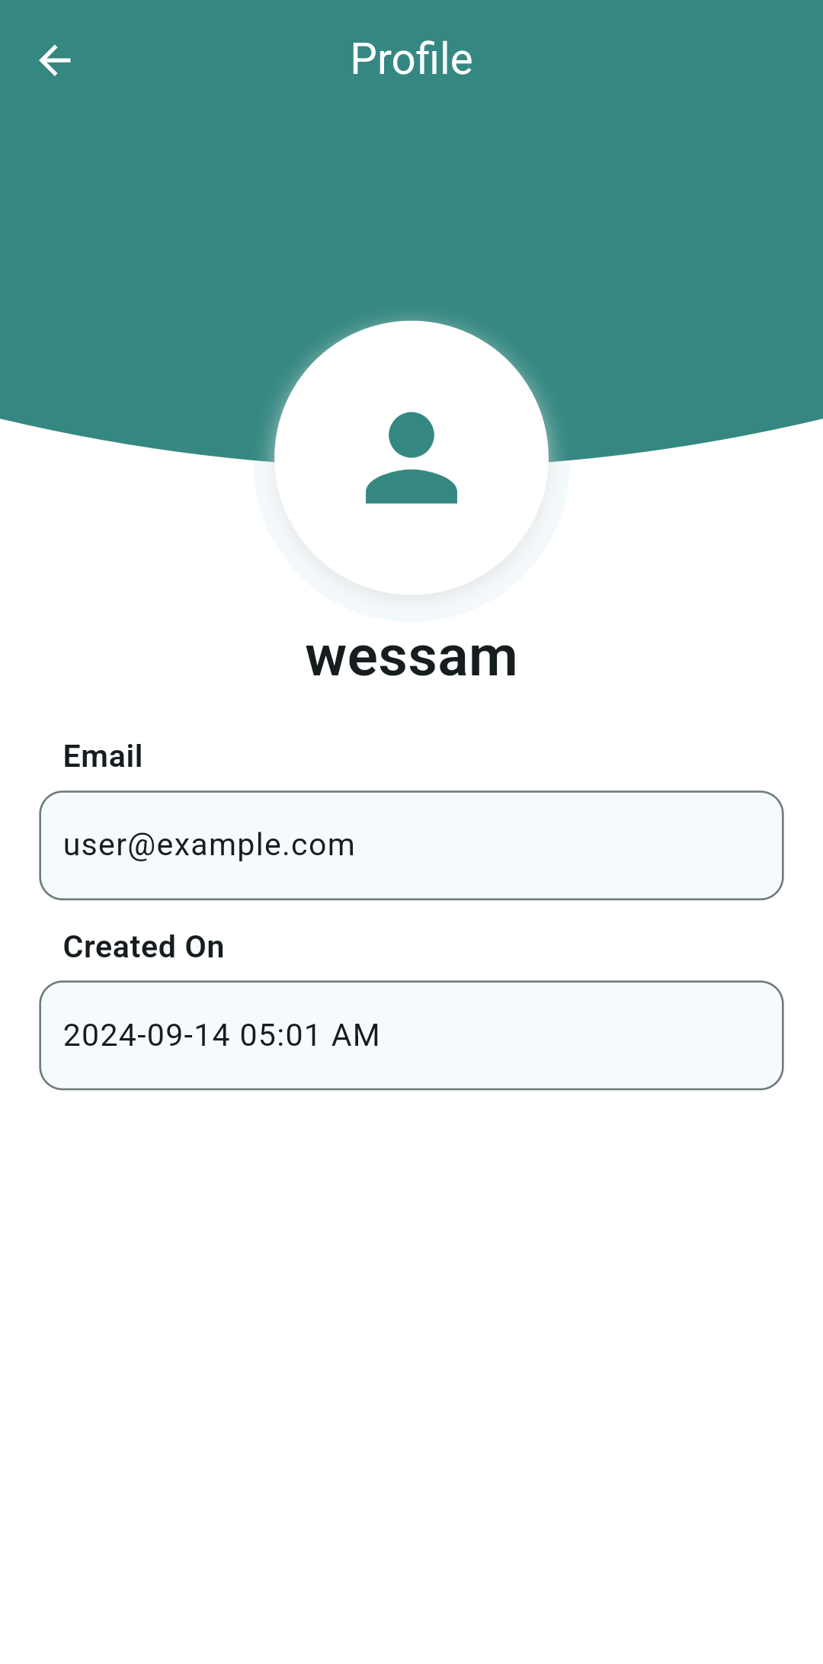
Personal Profile Page
The Profile page provides a space for users to view their personal information within the app. It typically includes:
Name: Shows the user's name.
Email: Displays the user's registered email address.
Created On: Indicates the date and time the user's account was created.

Slide 21
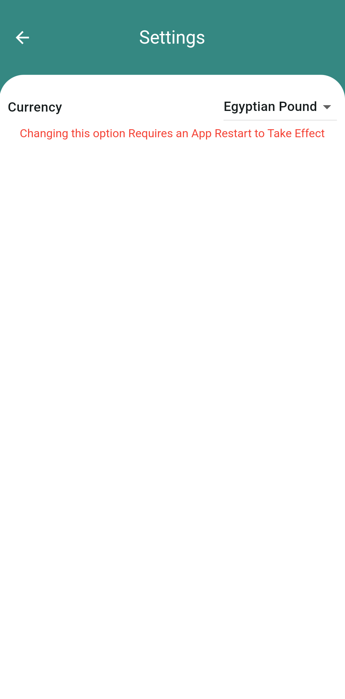
Settings Page
The Settings page allows users to customize various aspects of the app to suit their preferences. It typically includes options such as:
Currency: Users can select their preferred currency for financial transactions and reporting.
This page empowers users to personalize their app experience and ensure it aligns with their specific needs.

Slide 22
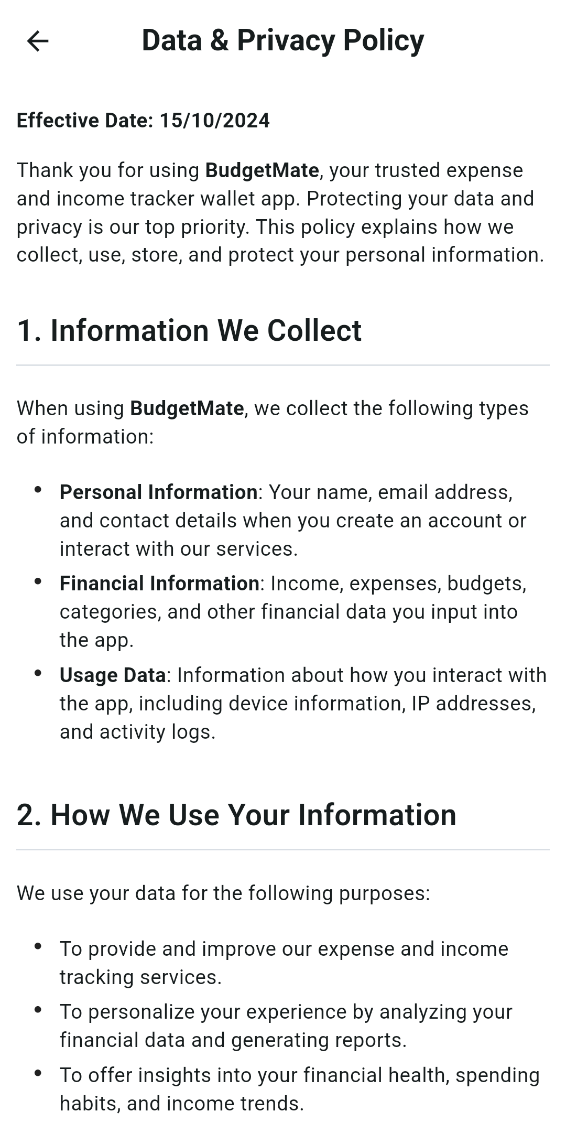
Data & Privacy Ploicy Page
This page outlines the app's policies regarding data collection, usage, and protection.
This page provides users with transparent information about how their data is handled, allowing them to make informed decisions about using the app.

Slide 23

Technical Stack
1
Frontend: Flutter
Cross-platform development for iOS and Android.
2
Backend API
Secure and scalable API to power the app.
3
Design Tool: Figma
Collaborative design and prototyping platform.

Slide 24




Development Approach
Agile Methodology
Iterative development with regular feedback.
Collaborative Teamwork
Each member focused on specific app features.
Thorough Testing
Rigorous manual testing to ensure quality.

Slide 25

Conclusion
BudgetMate empowers users to take control of their finances, providing a comprehensive solution for tracking income, expenses, and savings.
Future improvements may include advanced financial analysis and API integration for seamless data synchronization.

